Slide 1
The Swift Education and Public Outreach Program
Lynn Cominsky
Sonoma State University
February 5, 2008

Slide 2
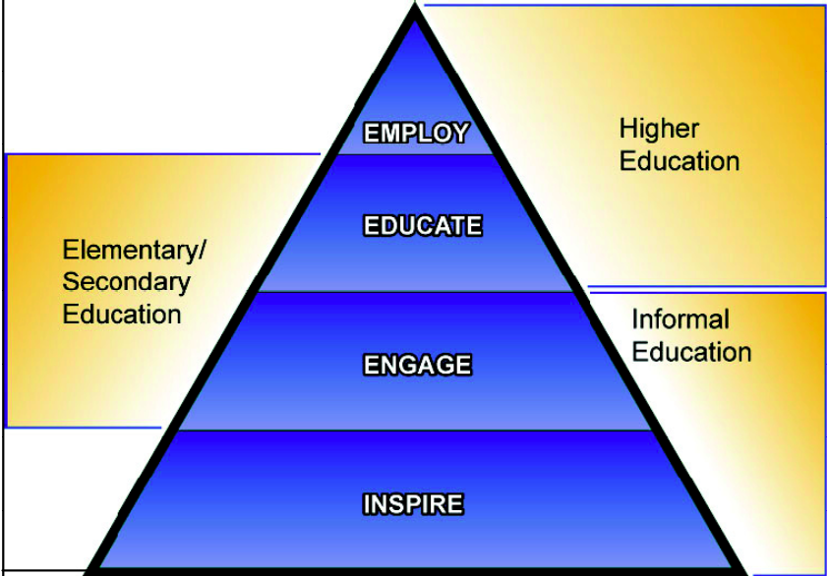
Senior Review E/PO Proposal Overview
New NASA Education Framework
Informal education and public outreach
Elementary & Secondary education
Higher Education
Emphasis on workforce development for under-represented populations

Slide 3
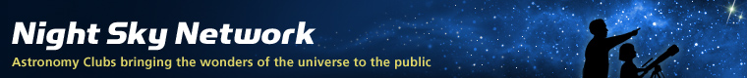
Informal and Public Outreach
Multi-media experiences
Popular websites
High-leverage activities conducted by the Night Sky Network of amateur astronomers

Slide 4
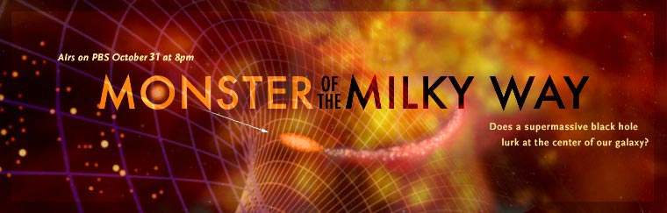
Multi-Media Experiences
Black Holes: The Other Side of Infinity
Features Swift launch and animation
Also PBS NOVA show features Swift
http://www.pbs.org/wgbh/nova/blackhole

Slide 5
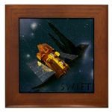

Swift Websites
E/PO site: http://swift.sonoma.edu
GRB SkyMap: http://grb.sonoma.edu
All bursts since August 2004
MySpace: http://myspace.com/swiftsatellite
Over 135 friends
Blog with current events
Facebook (must be a member to view)
Swift Newsletter: http://swift.sonoma.edu/resources/multimedia/newsletter/
Eighth issue now online
Science news, mission report, E/PO news and more!
CaféPress: http://cafepress.com/swiftsatellite

Slide 6
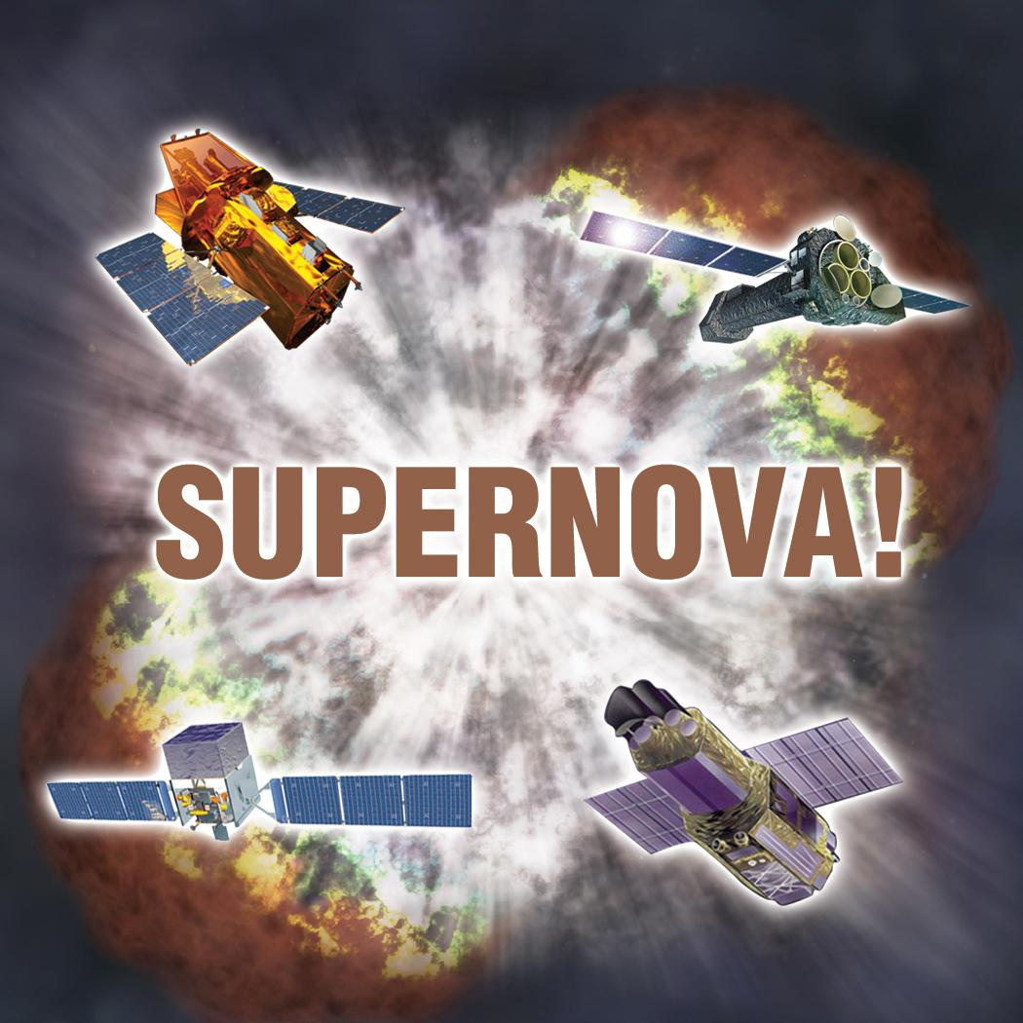
Supernova! Toolkit
NSN: Over 200 clubs nation-wide
Joint project with Suzaku, GLAST and XMM-Newton, developed by Astronomical Society of the Pacific

Slide 7
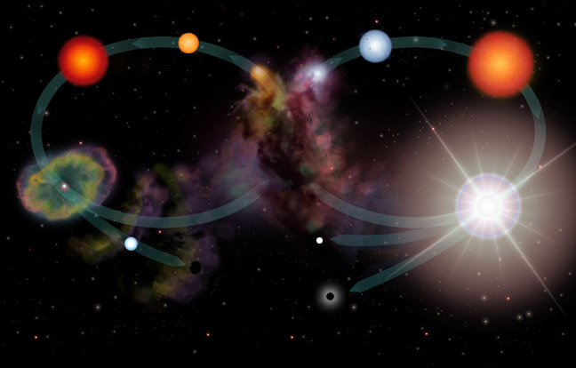
Supernova! Activities
Supernovae in the Lives of Stars
Life Cycles of Stars poster
Let’s Make a Supernova
Star Maps: Stars Likely to Go Supernova

Slide 8
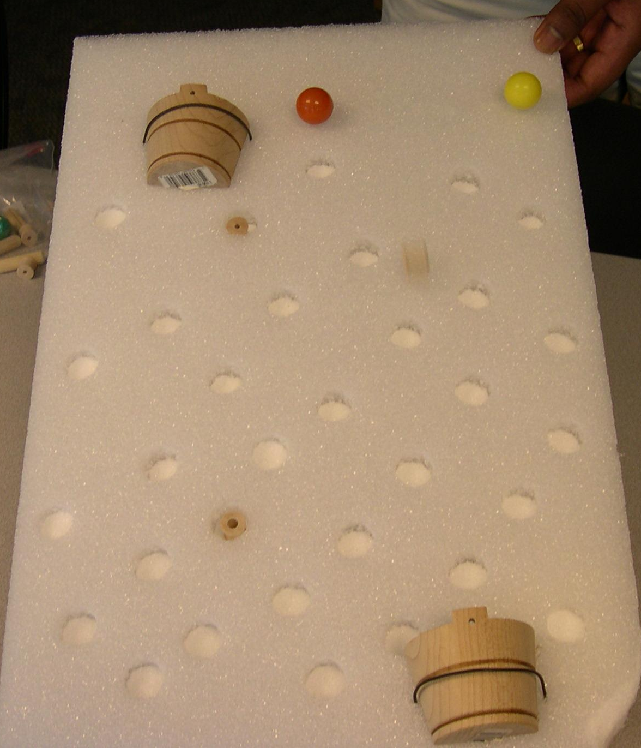
Supernova! Activities
Protecting the Earth from Cosmic Radiation
Nuclear Fusion, Cosmic Radiation and Supernovae
Protecting the Earth Activity
Air as a Shield
Gamma-ray Bursts

Slide 9
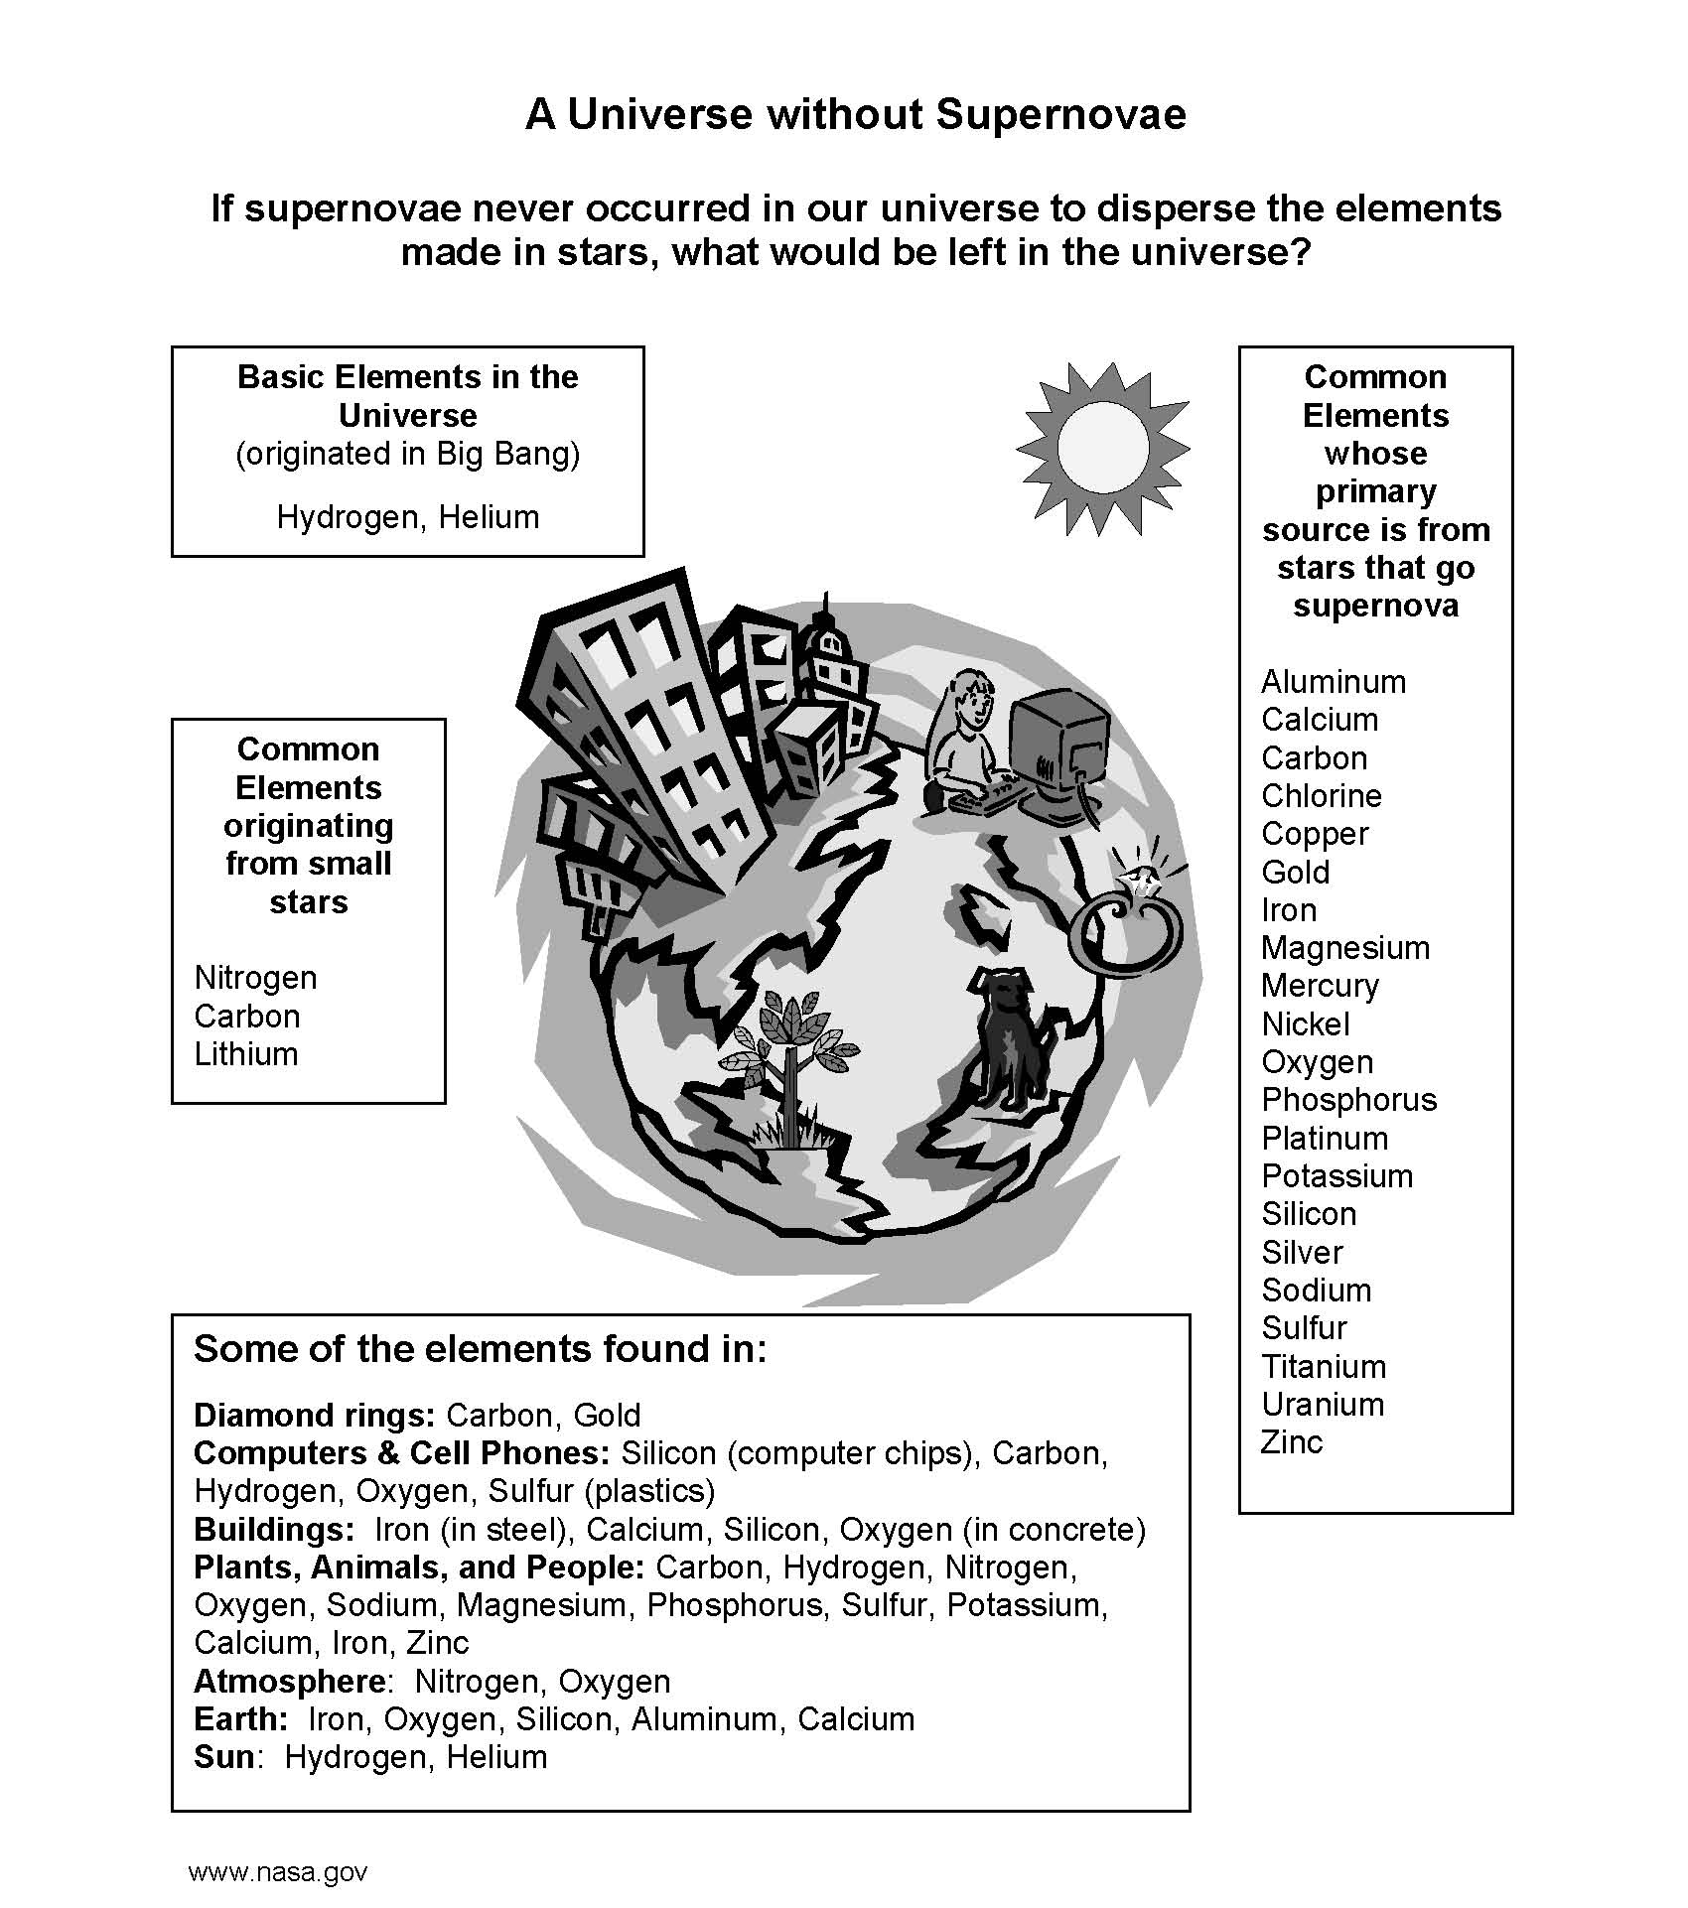
Supernova! Activities
Universe without Supernovae
Cosmic Connection to the Elements (GSFC)
Activity, Guide and Poster

Slide 10
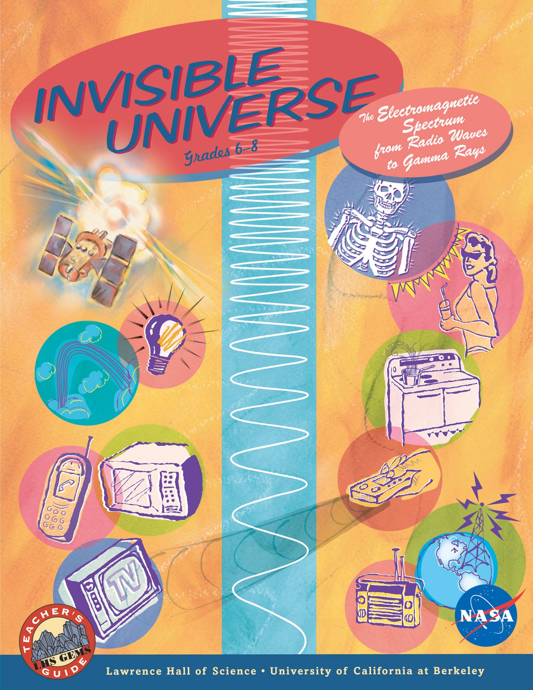
Elementary & Secondary Education
Standards-aligned classroom materials
GEMS Guide: Invisible Universe
GRB Educator’s Guide
Newton’s Laws Poster Set
Swift Eyes Through Time
Educator Ambassadors
After-School Programs

Slide 11
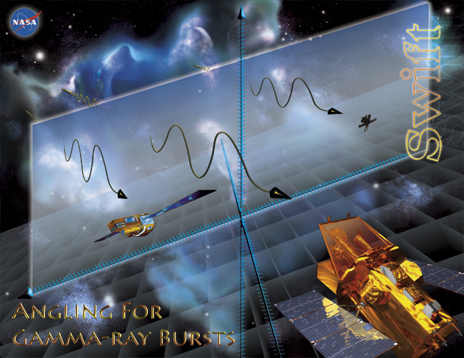
Classroom Materials for grades 7-12
Approved by NASA and in wide distribution:
GEMS Guide
GRB Educator’s Guide
Newton’s Laws Poster Set
GRB Guide Posters finally printed!

Slide 12
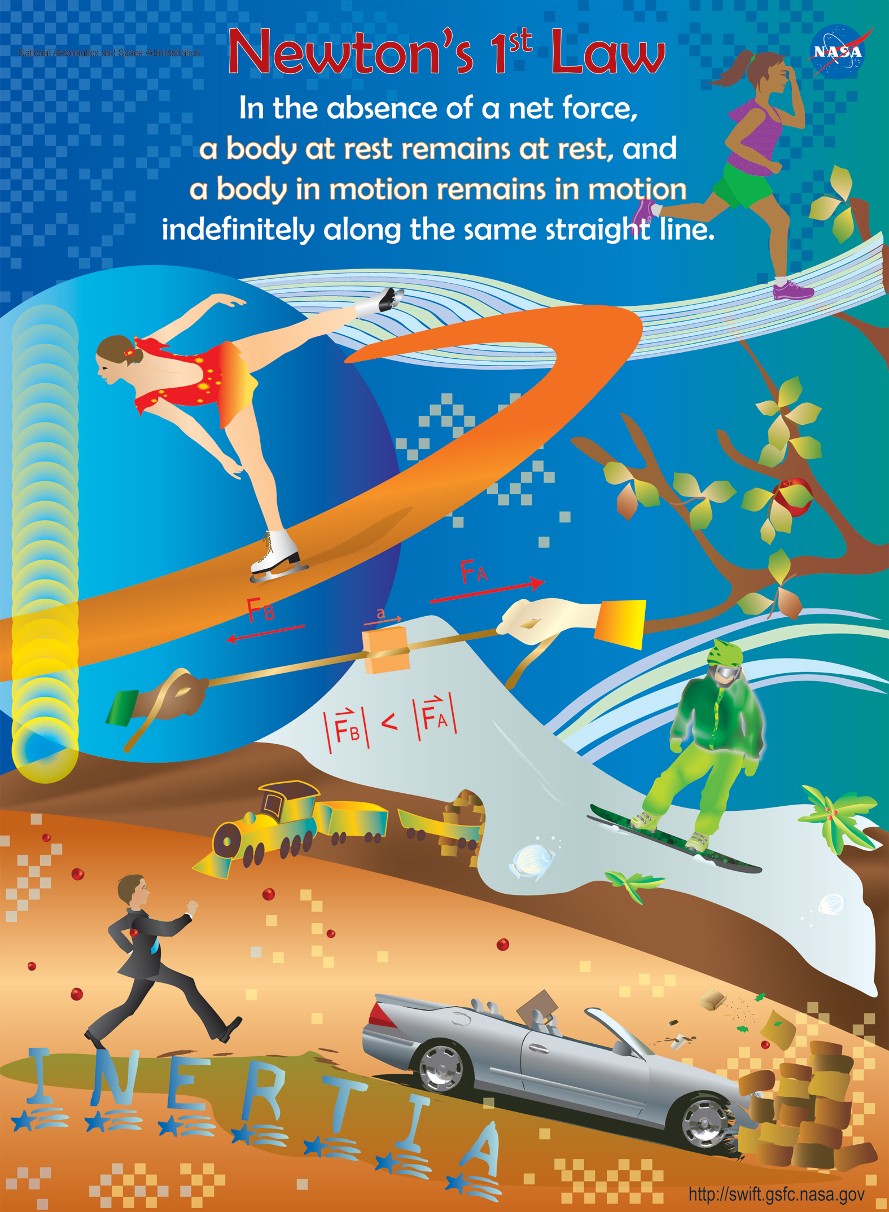
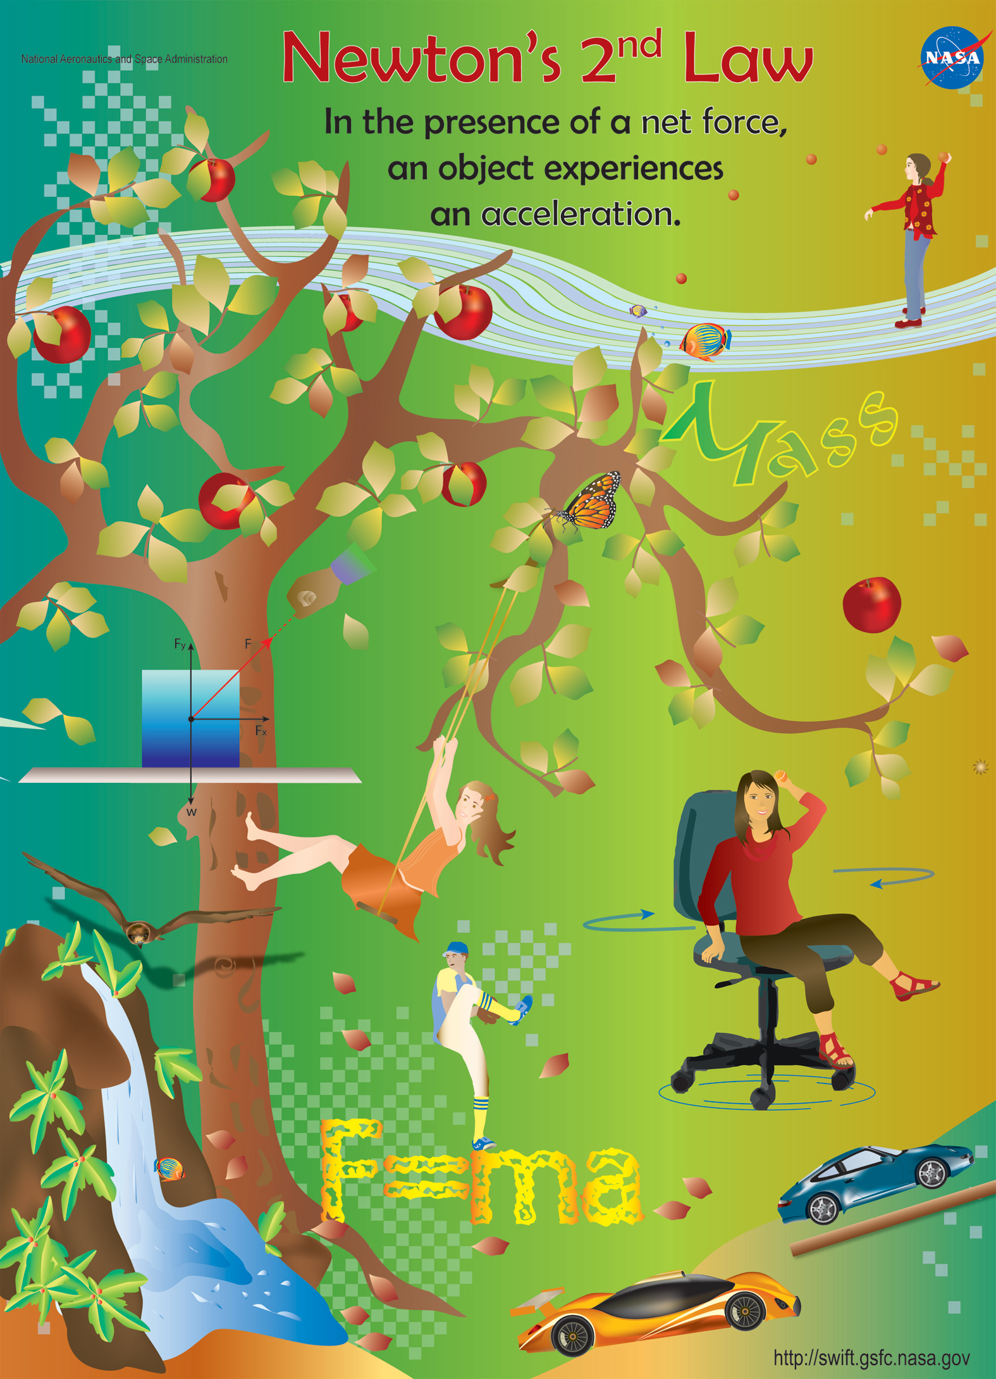
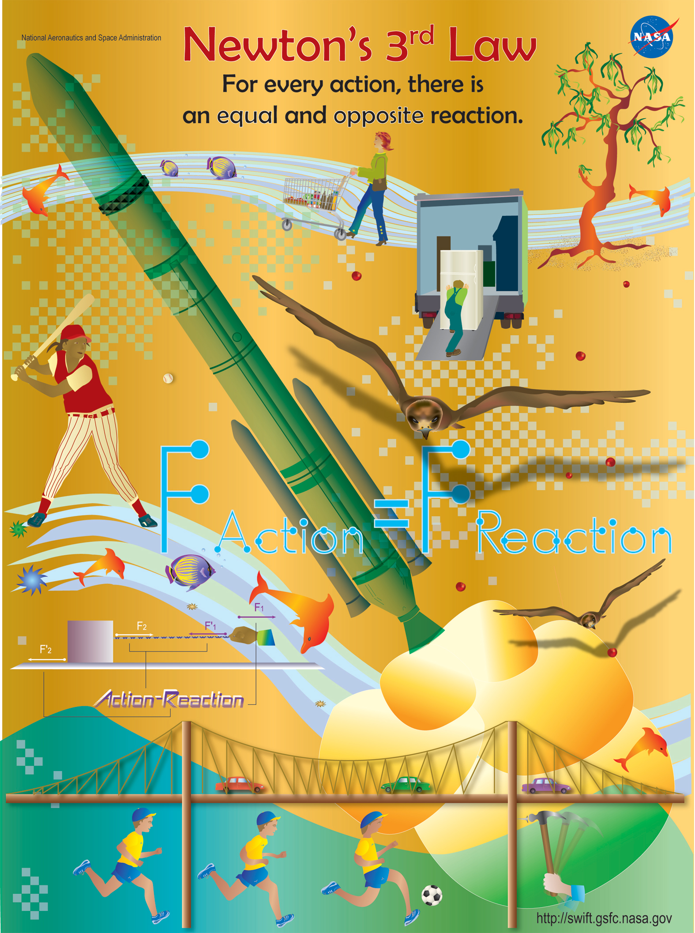
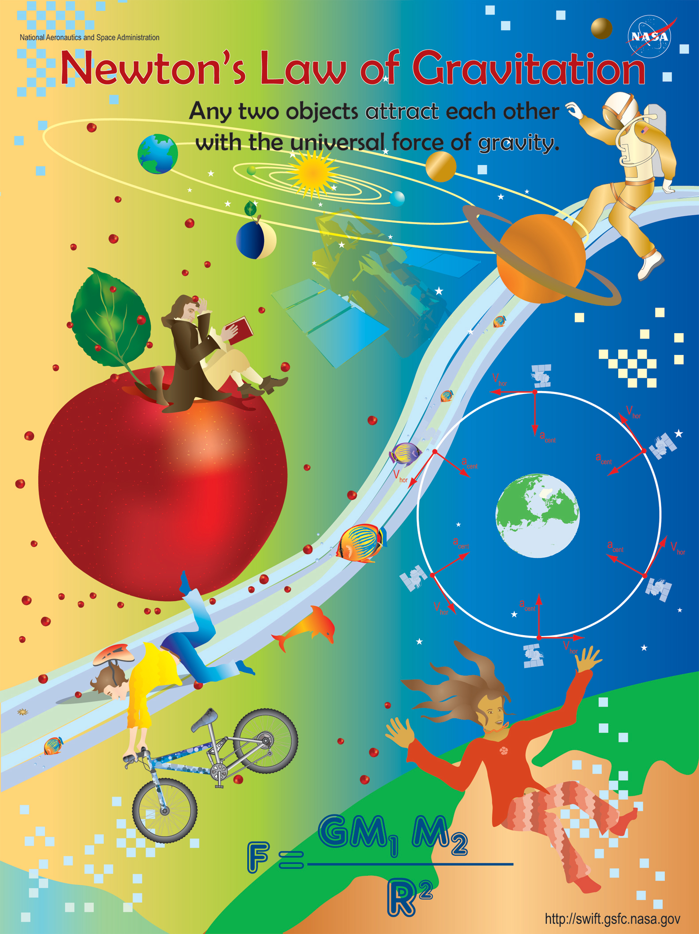
Newton’s Laws
Now available – limited number of sets without folds – write to lynnc@universe.sonoma.edu

Slide 13
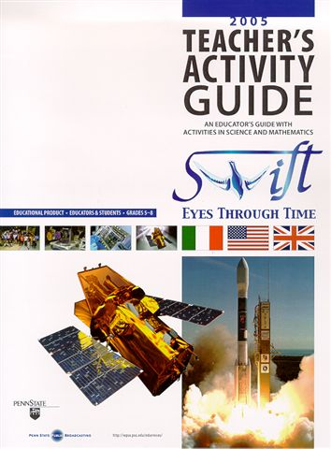
Penn State E/PO: Swift Eyes through Time
Six 5-minute video segments on a DVD, each with activity – some from WITN?
Focus is process of Science
Earth, the Universe and Culture
Theories
Accidental Discoveries
The Relationship Between Science and Technology
Looking Back in Time
Creativity in Science
Now in revision after NASA Product Review and available on-line
http://www.wpsu.org/swift/

Slide 14
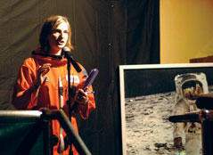
Educator Ambassadors Program
Swift supports 5 EAs
Rob Sparks (Arizona)
Rae McEntyre (Kentucky)
Bruce Hemp (Virginia)
Janet Moore (Illinois)
David Beier (Missouri)
Have reached over 7500 students and teachers through over 150 lectures, mini-courses and workshops
Next EA training: July 28 – Aug 1 at SSU
Janet Moore at CLC

Slide 15
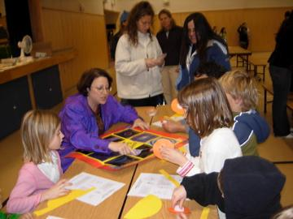
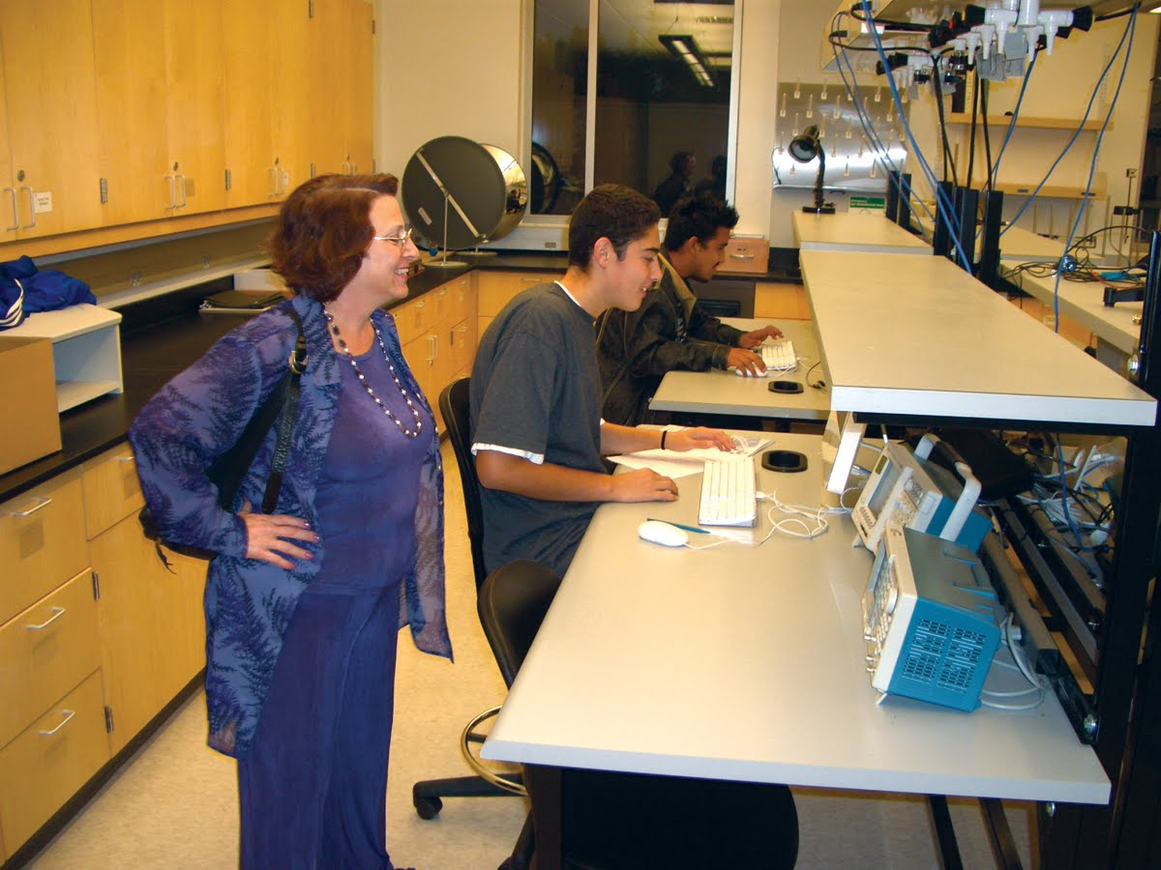
After-School Programs with Under-represented students
Roseland University Prep
2/3 of seniors now admitted to 4-year college for F2008
>90% Hispanic, low-income
After-school club since 2005
MESA Schools Program
Opened center at Cali Calmecac
MESA Engineering Program
In progress at SSU
Lynn and Aurore at Cali Calmecac
RUP student working on college applications

Slide 16
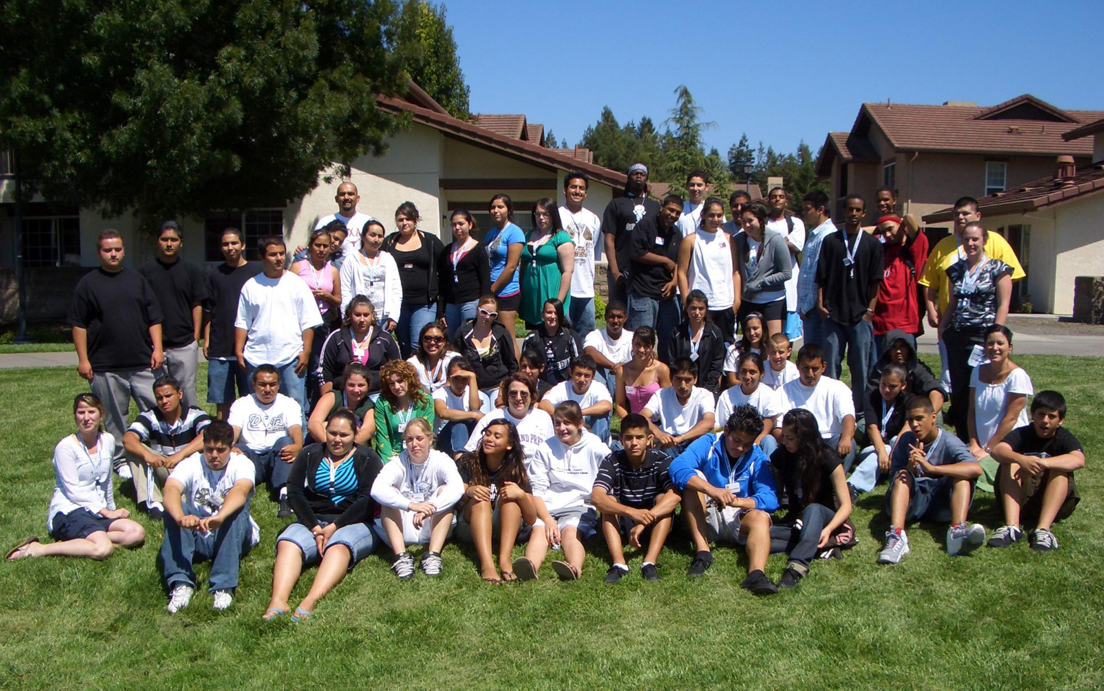
RUP Summer Experience at SSU
Last summer’s group
Will do this again in June, 2008 for rising seniors

Slide 17
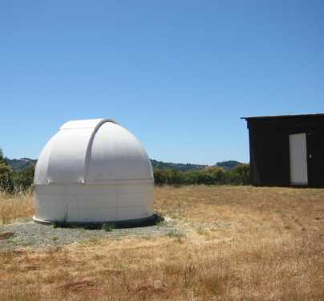
Higher Education
Authentic research experiences with high-school and college students through the Global Telescope Network
23 partner institutions
New partnership with Dr. Kim Coble at Chicago State University to develop college curriculum and work with African-American students
http://gtn.sonoma.edu

Slide 18
Swift PR Overview
Two scientific symposia at AAAS organized
2006: A Giant Flare from a Magnetar: Blitzing the Earth from Across the Galaxy
Hurley, Palmer, Gaensler and Inan
2008: The World-Wide Hunt To Solve The Mystery Of Gamma-Ray Bursts
Gehrels, Wells, Chincarini and Piran
33 Press releases to date (launch and beyond)
2008: 1 so far (More on the way!)
2007: 9 including Rossi Prize release
2006: 9
2005: 11 including first light of UVOT
2004: 3 including launch and first light of BAT, XRT

Slide 19
Press Releases
January 9, 2008 - Swift and Gemini Probe Mysterious Distant Explosion
December 18, 2007 - 'Shot in the Dark' Star Explosion Stuns Astronomers
October 30, 2007 - Swift helps shatter Black Hole Record
September 12, 2007 - NASA Astronomers Find Bizarre Planet-Mass Object Orbiting Neutron Star
July 30, 2007 - Japanese and NASA Satellites Unveil New Type of Active Galaxy
June 26, 2007 - NASA's Swift Sees Double Supernova in Galaxy
May 22, 2007 - Gamma-ray Bursts Active Longer Than Thought
March 15, 2007 - Robotic Telescope Unravels Mystery of Cosmic Blasts

Slide 20
Press Releases
March 8, 2007 - Gamma-Ray Birth Cries Suggest Massive Magnetic Engines
January 16, 2007 - Top High-Energy Astronomy Prize Awarded for Swift Discoveries
December 20, 2006 - NASA Satellite Discovers New Kind of Black Hole Explosion
November 21, 2006 - Twin Star Explosions Fascinate Astronomers
November 6, 2006 - Monster Stellar Flare Seen by NASA Scientists Dwarfs All Others
October 5, 2006 - NASA Performs Headcount of Local Black Holes
October 5, 2006 - Scientists Determine The Nature Of Black Hole Jets

Slide 21
Press Releases
October 4, 2006 - Mug Shots of Supernovas Reveal Two Key Findings
August 30, 2006 - Caught in the Act, Scientists Watch Supernova Explode
May 12, 2006 - X-rays Fly as Cracking Comet Streaks Across the Sky
February 24, 2006 - Scientists Detect New Kind of Cosmic Explosion
December 14, 2005 - Cosmic Explosion Could Be Black Hole Swallowing Neutron Star
October 5, 2005 - In A Flash Nasa Helps Solve 35-Year-Old Cosmic Mystery
September 12, 2005 - Most Distant Explosion Detected, Smashes Previous Record

Slide 22
Press Releases
August 18, 2005 - NASA's Swift Satellite Finds Newborn Black Holes
May 11, 2005 - NASA Scientists Catch Unique Gamma-Ray Burst
April 5, 2005 - Swift Mission Nabs Its First Distance Measurement to Star Explosion
February 18, 2005 - NASA Observes One of Brightest Cosmic Explosions
February 15, 2005 - NASA's Newest Observatory Detects Record-Making Gamma Rays
February 01, 2005 - Swift Sees Pinwheel Galaxy, Satellite Fully Operational
January 21, 2005 - Swift Mission Images the Birth of a Black Hole
January 5, 2005 - NASA Swift Mission Turns on and Sees a Blast of Bursts

Slide 23
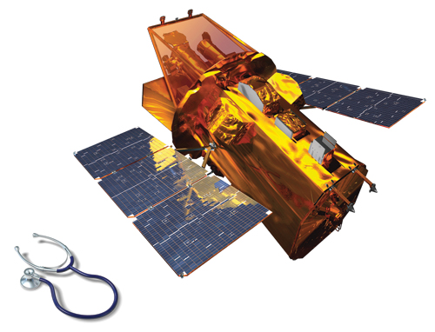
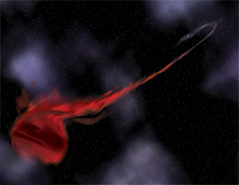
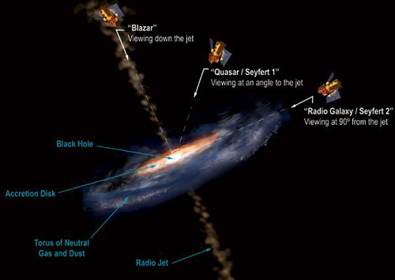
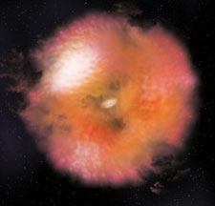
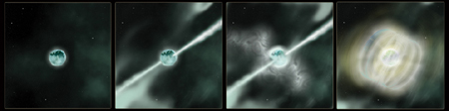
Recent Press Art
By Aurore Simonnet

